Slide 1
Ethical Hacking Assignment
Presented by Noel Varghese

Slide 2
Reverse Engineering-An Introduction
Assume that you are in possession of a microprocessor.The microprocessor is a finished product of components,such as transistors,registers etc.
The product can be broken down,to its simplest form,i.e separated components and can be built back again,to it’s final product,i.e the microprocessor
The above process is known as Reverse Engineering.
It means to break down a large component,into sub-components,to find out it’s working and disassembly and rejoining them back.
It is prevalent in the fields of Computer Science,Engineering etc.

Slide 3
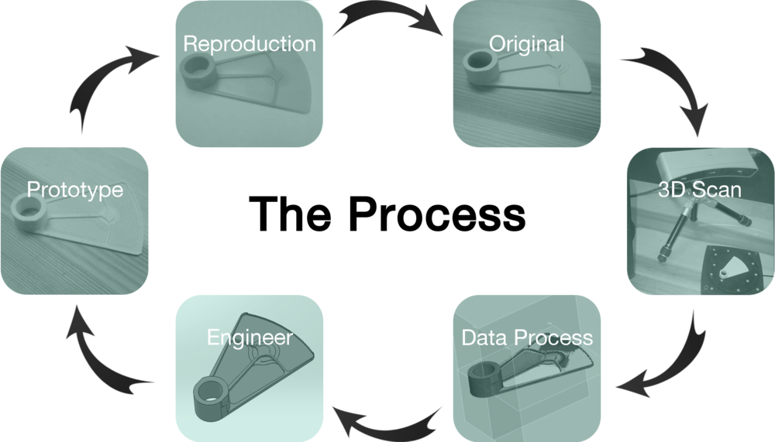

Slide 4


Reverse Engineering-It’s application in Ethical Hacking
Let’s take an example of the 40616 exploit from exploit-db
It i used to elevate privileges as root,in Linux 2.6.22 version onward
Instead of automating the exploit execution and escalating privileges,a budding pentester can try to understand how the exploit script works,How it is able to create a root shell,by overwriting the /etc/passwd file,on the victim’s machine.
Understanding the functioning behind the script and able to program from inside out,helps to understand the exploit execution.

Slide 5
Reverse Engineering-It’s dark side
Copyright Law and Patent Law
Undesirable Actions:-
Attempting to reverse engineer a unreleased program can cause legal consequences.
Third parties trying to reconstruct a source code
Example-Sega Enterprises Ltd. v. Accolade Inc.
This case concerned Sega's video game console and cartridges. The cartridges had a 20-25 byte code segment which was interrogated by the console, as a security measure.
Accolade disassembled the code which was common to three different Sega games cartridges, to find the security segment, and included it in competing games cartridges.
The Ninth Circuit held this disassembly to be a permitted "fair use" of the copyright in the games' programs. The disassembly of copyrighted object code, as a necessary step in examination of the unprotected ideas and functional concepts embodied in the code, is a fair use that is privileged by section 107 of the Copyright Act: because disassembly was the only means of gaining access to those unprotected aspects of the program, and because Accolade has a legitimate interest in gaining such access (to determine how to make its cartridges compatible with the Genesis console).

Slide 6
Reverse Engineering Methods
Fuzzing-Applying incorrect inputs to check if vulnerability is displayed by the application
Helps to uncover errors within program and prevent zero day vulnerabilities
A program will not be susceptible to fuzzing,if it has a whitelist implemented
Vulnerabilities must be fixed,in the form of patches.
SPIKE-Various API calls are used to push data,into a spike and the send the spike to the application being fuzzed.
They include static data,dynamic length values,fuzzing variables

Slide 7
Tools used for Reverse Engineering
Hex Editors-Used to read binary files,uncovered during pentesting process.
It may contain information,about the system and its processes
Portable Executable and Resource Viewer-Used to edit resources,such as menus,dialogs,cursors etc,that are embedded in an executable file

Slide 8
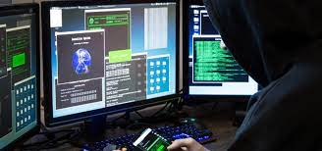
Continued
Tools:-
Debugger-gdb and dbx-Involve hex dumping and finding possible errors/bugs
Decompilers and Disaasemblers-Ghidra and Hiew
Hex Editors-SlickEdit and Notepad++
Resource Editor-ResEdit and ResourceTurner-Modify resources in a Visual Studio code

Slide 9
Considerations
Failure to check for error conditions
Poorly designed protocols
Poor understanding of function behaviours
->Have prior permission of organization,before conducting it
->Act in good faith
>Stay loyal to your duty,i.e finding possible vulnerabilities or bugs

Slide 10
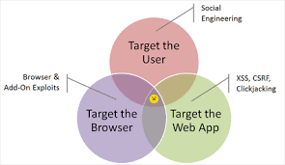
Client Side Browser Attacks
Deals with infection of client’s browser,causing undesirable actions,such as rerouting to spoofed website,ActiveXControl script execution etc.
Attacks can be:-
Targeted-Upon specific entity or organization
Random-Attack maximum number of people possible
Why?-To gain sensitive information
To infect victim,with ransomware
Change security configuration,via LSA

Slide 11
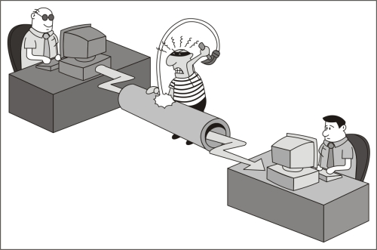
Progression of Attack
Selection of victim
Browsers are susceptible to attacks,since they have administrative privileges.
These privileges can be exploited,for code execution on client side,with same level of rights
Malicious code gets injected and run.It can either intercept user sessions,redirection to spoofed websites etc.
Attacker gains control over the victim machine
Attack types can be XSS or Content spoofing

Slide 12

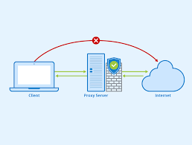
Types of Attacks
Fire and Forget-More like a random attack
The attacker needs to be in vicinity for conducting attack and receiving confirmation that target has been compromised
Prior to launch,the information about target,received by reconnaissance is fed into the script.
It used to be prevalent before,but is now blocked by default firewalls,such as Windows Firewall,on systems
Requires client side administrative privileges
Examples-Blaster and Slammer

Slide 13
Attack Exploits-Derived from exploit-db
EDB-ID Description
47752 Mozilla Firefox,for Windows 10,64 bit OS
30299 Client Side Filtering Bypass,on WebApps
12258 SMB Client side bug,for Windows OS
48325 Macs Framework 1.14f-Persistent Client Side XSS
48186 Google Chrome 80 - JSCreate Side-effect Type Confusion (Metasploit)

Slide 14
Preventive Methods
Usage of firewalls or proxy servers.Offers standard,yet basic protection and least visibility
Specify security zones on a browser.It is similar like access control lists
Implemented by Internet Security Explorer
Restricted Zone-Websites assigned to this zone cannot execute ActiveXControl scripts.It is offered least rights and is used to view emails
Intranet Zone-Allows execution of AXC scripts,along with ease of a few restrictions.Some level of trust is shown here.Only involves sites on your LAN

Slide 15
Continued
Internet Zone- It is a catchall zone for sites on the Internet that another zone doesn't already classify. By default, every site you visit that doesn't have membership in another zone inherits the security permissions that the Internet zone defines.
Trusted Sites-Full access control is placed here.Security certificates are need to browse such websites.It may provide least to no security threats to the user.
Other modes of protection:-
Update applications and browsers
Install security patches

Slide 16
References:-
https://www.blackhatethicalhacking.com/articles/free-access/reverse-engineering-hacking-tools/?__cf_chl_jschl_tk__=293bf4cdb24f7b26c4323388f164fbd347da4dde-1619666970-0-AfpdRLkVt0aCeI_xfLCzpYHdBvkel4QwzUT2tQ6BYAPCAQIvybOQCMJxJoM9sNQK4t5YSOFmL5Efe1PAD2Ad7QKwXEsPte-NDf43aUmr-DbjE16HYVtnhZOnyl4-qvQRVcpZ41fxKePOw3He7rPxfaUdFOzKqSQekt-wOsWD-lQSKAtHhZ3mn3OHK9fl1jcH0CL1lX8S6F7enhyKPo4T3BcmINAwanqNFIDVepreQN4fj7dIEMhgWe8JzaLa7bonf9wS2CPB6i4W8Mazhebu6cw-GGrZrmnFzy-7WV6_MBU4IMURf57IkTVCCFSek2WRca1zbMyoLcvHJABCWoFuD1cjaZKK9Gge1GUO9RjyiG-_CCdpOdbaQs6gKiF4Y8DOZfHzXKv8t8ZccO6o2-5xH8xD8B_258tT4pPS7K6iPKVKXFqSZQFjIjIxUQ7zOI2sTtdCdqPnAruvnjbjq9U8Qrk
https://www.ibm.com/docs/sv/snips/4.6.2?topic=categories-client-side-attacks
https://www.exploit-db.com/exploits/40616
https://en.wikibooks.org/wiki/Reverse_Engineering/Legal_Aspects#Famous_Cases
https://www.itprotoday.com/security/guide-internet-explorer-security-zones

